Slide 1
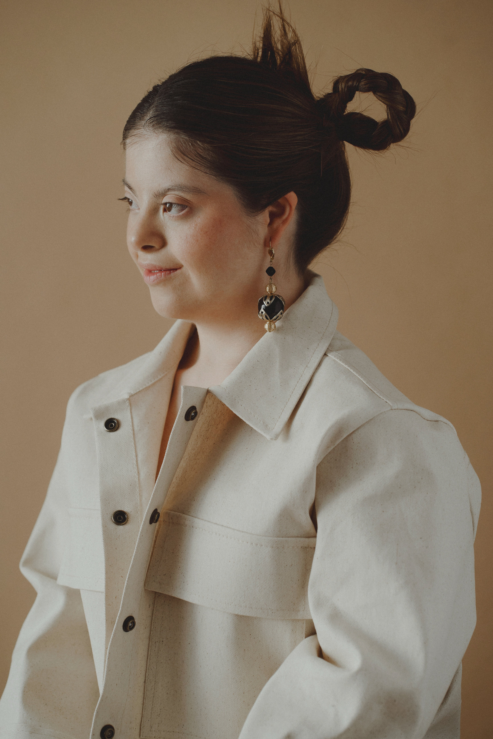

world of fashion
AURA
COUTURE
PRESENTED BY
DEEPIKA LUTHRA

Slide 2
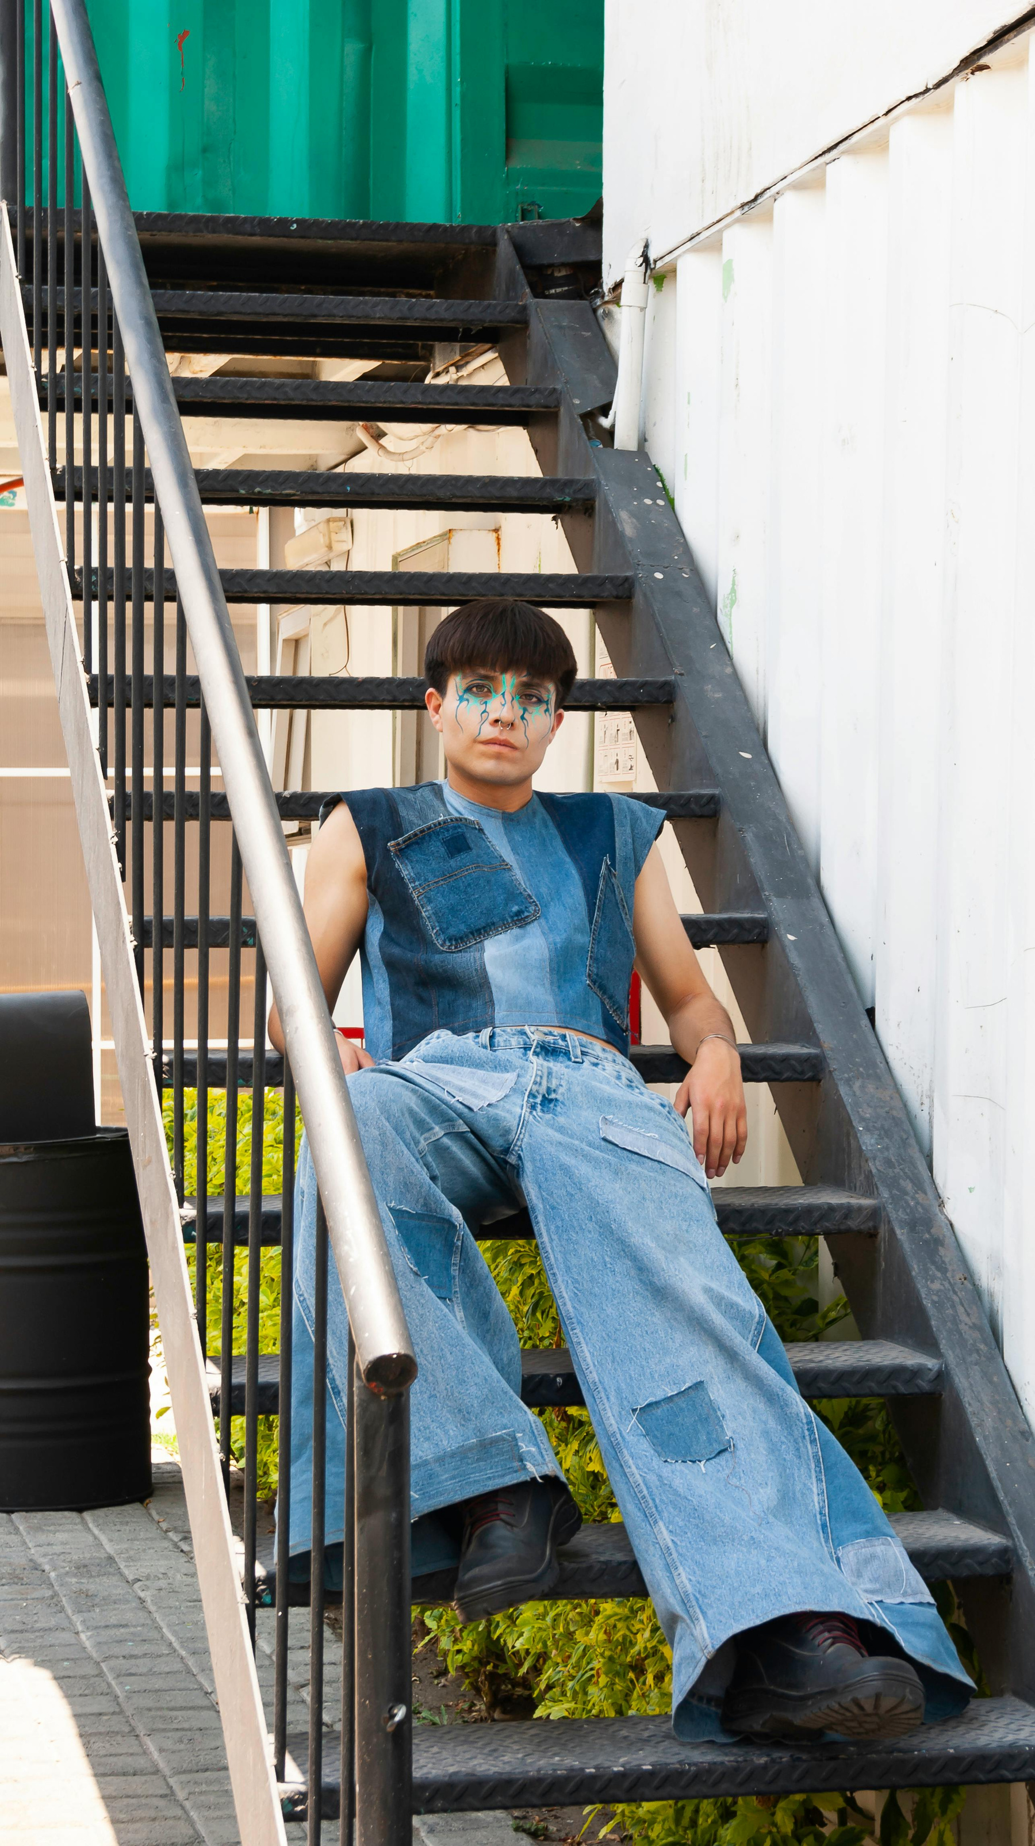
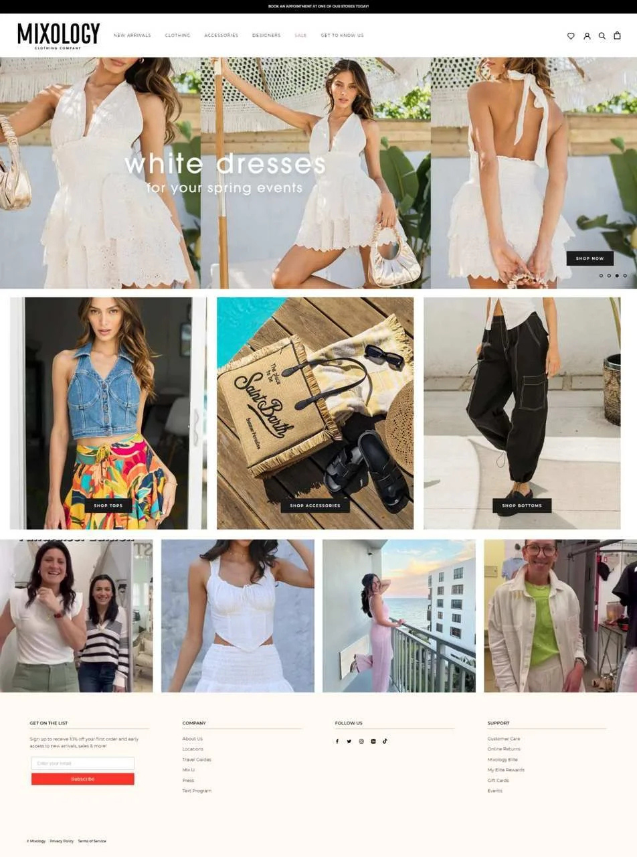
Business Overview
Slide 05
Why Aura Couture?
  Aura Couture offers a huge variety of stylish clothing and customization that you would not find in Terrace
  We provide high-quality outfits at reasonable and affordable prices.
  Our designs are unique, comfortable, and made with care so customers feel confident and special.

Slide 3
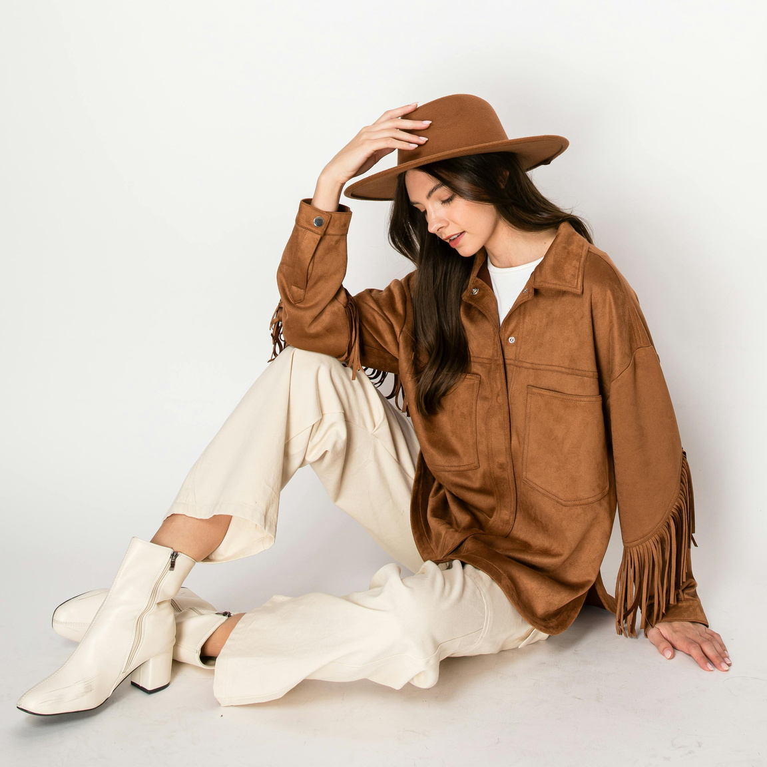
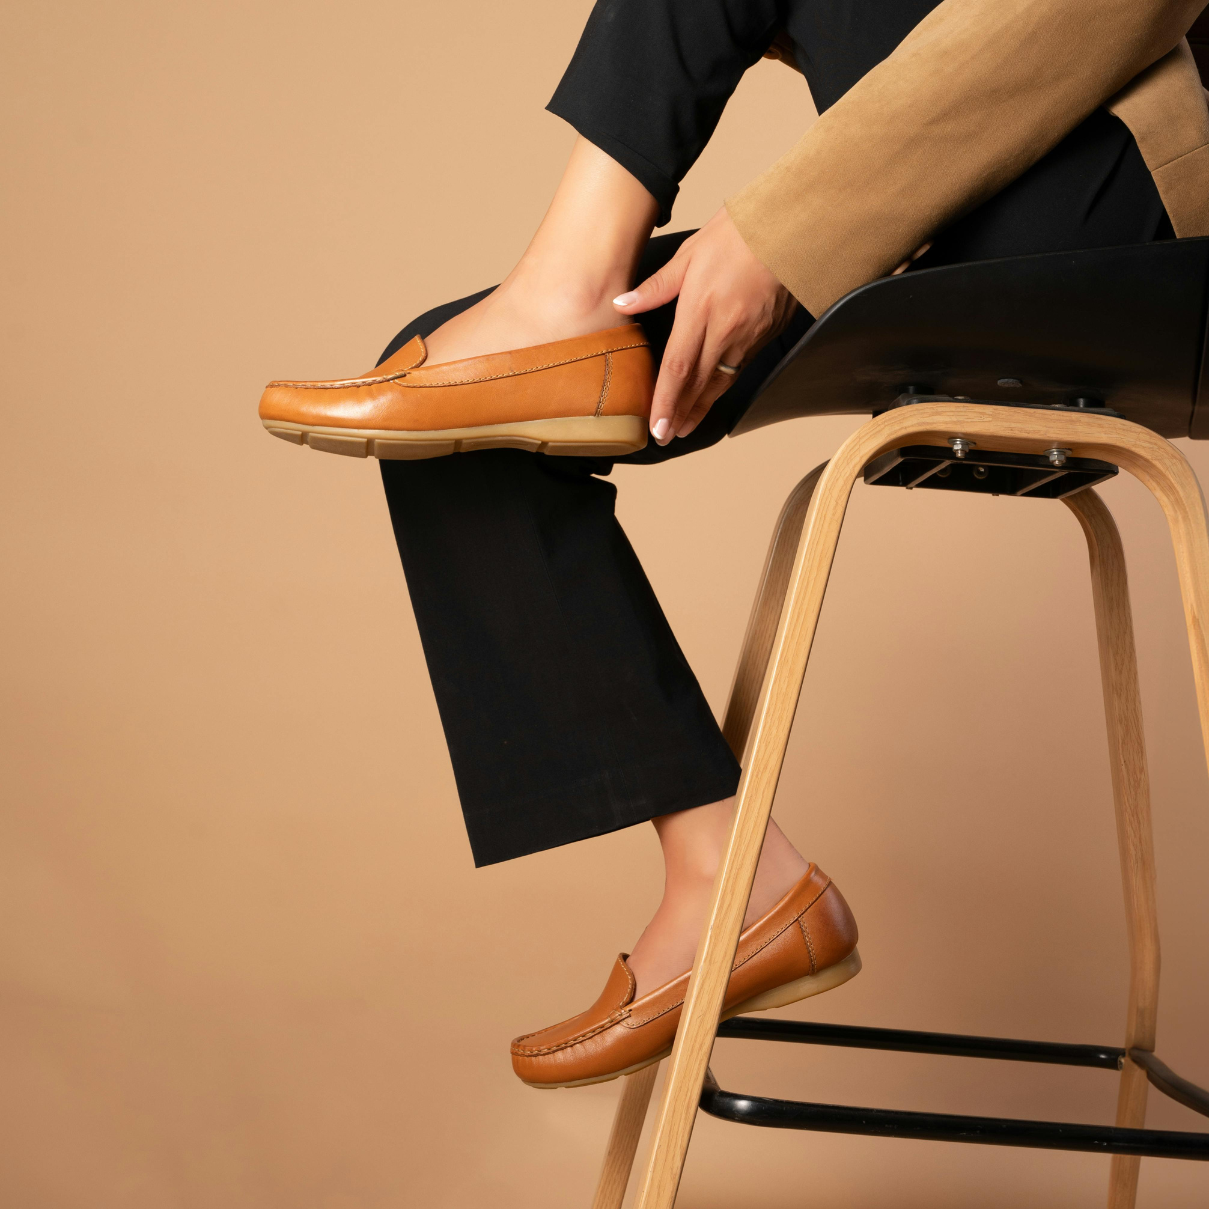
Target Market & Demand
Target customers
  Our target customers are people in Terrace who want stylish, comfortable, and good-quality clothing.
  We focus on customers who prefer affordable fashion with many design choices.
Geographic Scope
  We mainly serve customers in Terrace, British Columbia through local sales and online orders.
  Our service area may grow in the future, but right now our focus is on the Terrace community.
Trends in Customer Behavior
  Customers are looking for good quality clothing at reasonable prices with a variety of styles.
  Many people prefer local brands and want modern designs that are easy to wear every day.

Slide 4


Business Model & Growth
How we work
Start by selling at local farmer’s markets in Terrace.
Sell through WhatsApp, Instagram, and online store.
Take custom orders for customization and alteration, focus on variety quality, and fair prices.
Growth
  0–3 months: Set up social media and start taking small orders.
  4–6 months: Increase marketing and begin delivery options.
  6–12 months: Expand clothing line, boost ads, and plan for a small store.

Slide 5
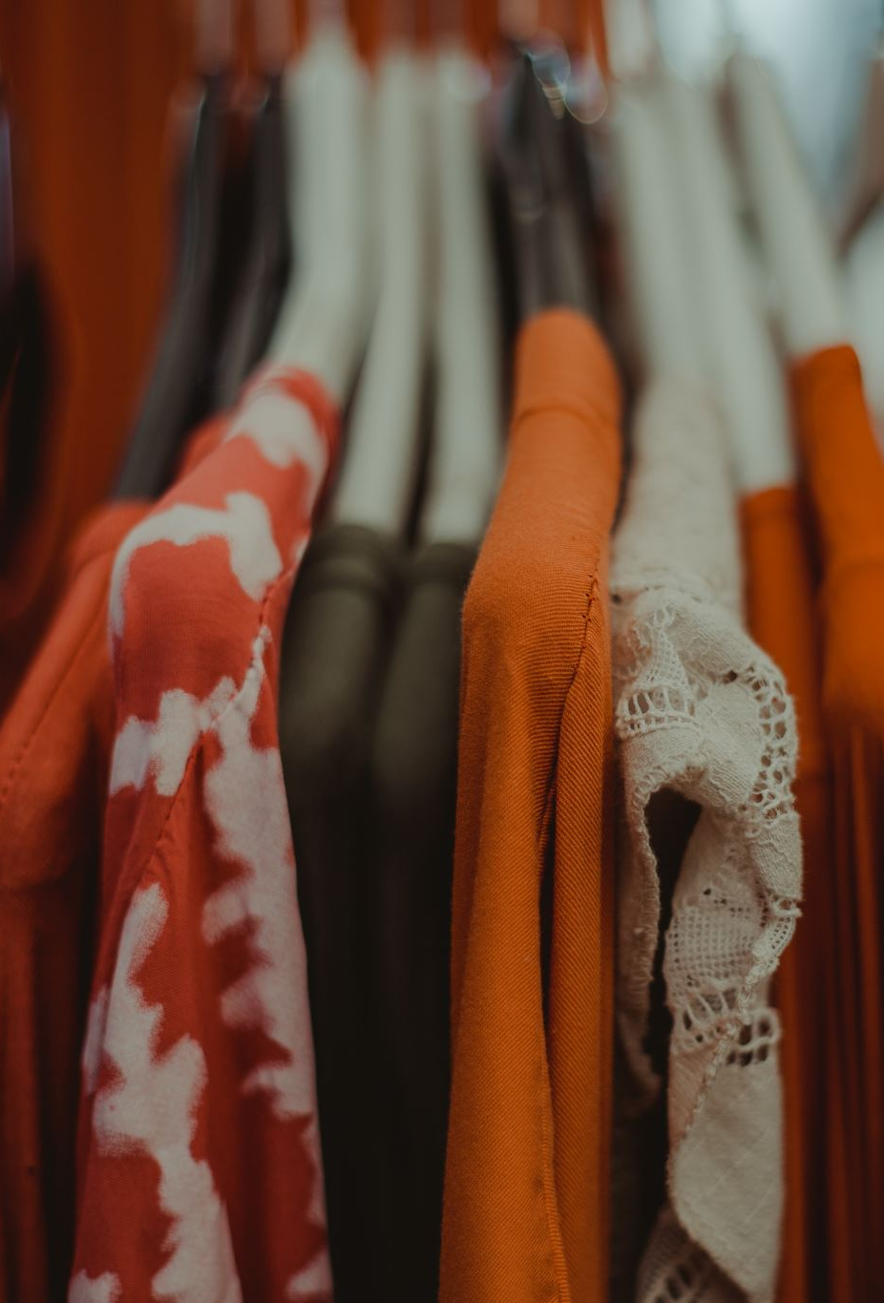

Financial Projection
Aura Couture is projected to begin earning strong revenue in the first year. According to our financial statements, Year 1 total revenue is estimated at about $159,685, coming mainly from clothing sales, accessory sales, and custom orders. Because we are operating from home, our costs remain low, and our expenses for Year 1 are projected at $63,590, which allows the business to generate an estimated net profit after tax of $84,563 in the first year.
As sales continue to grow and the brand becomes more recognizable, Aura Couture is expected to improve its cash flow and increase profits over the following years. Overall, the financial projections show a positive and sustainable growth .

Slide 6

Investment Opportunity
What we want
In search of partners in supplies, debt funding or mentorship
The money will be used for physical store setup, marketing and operational growth
Why make an Investment ?
Strong forecasts for volume and the possibility for profitability.
An opportunity to help an expanding stylish reasonable clothing market.

Slide 7
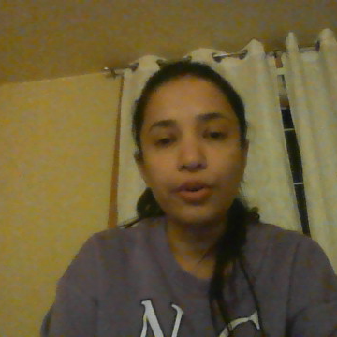
Final thought & contact
We are excited to share the variety of stylish reasonable and customization clothes for every occasion with more people .
We welcome investors who believe in our vision and want to grow with us
Let’s connect
If you are interested in investing or supporting us at
Auracouture@gmail.com

